Slide 1
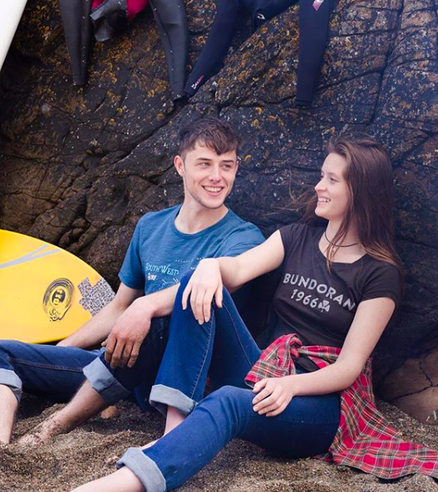
Marketing Strategy for Tonn
Deirdre Norgrove-15343481

Slide 2
Presentation Brief
Analysing current brand strategy
Tailoring business strategy to match new brand positioning
Integrating new marketing message to the new brand positioning
Recommendations

Slide 3
Tonn’s current brand statement
‘Inspired by the Irish surfing coastline and landscape, we are a specialist T-shirt company in Ireland that cares about providing great clothes while using only ethically sourced organic cotton from transparent manufacturers who we know and visit regularly’
Notes:
Reference:
Tonnstore.com 2018. Irish Designed Organic T-shirts inspired by Ireland. Available from: https://tonnstore.com/ [Accessed November 24, 2018].

Slide 4
External Environment & Industry Structure
Factor | Key Issue for Tonn
Generational shift towards sustainability | Accentuate ethical aspect in production process to deliver value to this segment
Highly saturated market/High buyer bargaining power | Need to differentiate/innovate
High barriers to entry | Difficulty to make full use of existing/avail of better distribution channels
Notes:
Main takeaways and key Issues identified during PESTEL analysis and Porter’s five forces
Full PESTEL analysis:
Full Porter’s Five Forces:
Threat of New Entrants
Barrier to Market Entry
Saturated market for new entrants/High buyer bargaining power
Magnitude of Barrier
High
Who/What/How likely 1.Verja/Sustainable shoe brand (worn by Megan Markle) could extend range to include sustainable t-shirts/Likely (product extension) 2.Irish Souvenir stores (eg. Carrolls)/Start making higher end Irish slogan tees/Likely (market there)
Supplier Power
Who/What/How likely
Cotton t-shirt supplier/Forward integration (making their own t-shirts)/Likely
Forward Integration
Not presented with any evidence of threat of forward integration from our supplier
Buyer Power
Who/What
Sustainable consumers/Brand awareness of Tonn over others
Women buying gifts for men/Preference over other brands
General customers/Website and small number of vendors
Backward Integration
Not presented with any evidence of backward integration
Substitute Products
Who/What/How likely
High street retailers/Eco-friendly slogan tees/Indefinite
Verja/French sustainable shoes/Exists
Women buying gift for men/New technology, cologne etc/Likely
Market Rivalry
Who/What
Fat Face/“Fat Face is a lifestyle clothing and accessories retailer, based in the UK. It was founded in 1988 by Tim Slade and Jules Leaver as a business selling T-shirts at ski resorts” (Revolvy 2018)
Grown Clothing/“Irish ethical clothing company that is inspired by the sea, coast and wildlife of Ireland. We only use organic, post-consumer and earth friendly material” (Grown 2018)
Due South/“Unique eco friendly and sustainable t-shirts designed and printed by hand in Dublin, Ireland.” (Due South 2018)
Vedonaire/“Vedoneire is a classic Irish heritage brand established in 1951. We produce Mens and Womens clothing” (Vedoneire 2018)
Saturdays (NYC)/’In 2009, Saturdays NYC’s founders Colin Tunstall, Morgan Collett, and Josh Rosen combined their mutual lobe of surf culture with their interest in design, music, and coffe, amongst other things. The result? Probably one of the coolest stores in New York. Their Soho store features a coffee shop, artist exhibitions and surfboards alongside their menswear collections, becoming the go-to downtown hang-out’. (The Idle Man 2018)
References:
Porter’s Five Forces:
Due South 2018. Due South Clothing Dublin, Ireland. Available from: https://www.duesouth.ie/ [Accessed November 24, 2018].
GROWN. Available from: https://www.grown.ie/ [Accessed November 24, 2018].
Mackie, G. 2014. Fat Face profits rise despite flotation u-turn. The Scotsman. Available from: https://www.revolvy.com/page/Fat-Face Accessed November 24, 2018].
The Idle Man 2018. Saturdays NYC Sanders Long Sleeve Striped T-Shirt White. Available from: https://theidleman.com/saturdays-nyc-sanders-long-sleeve-striped-t-shirt-white.html [Accessed November 24, 2018].
Vedoneire 2018. Vedoneire of Ireland (est. 1951) - classic heritage clothing for Men and Women. Available from: https://www.vedoneire.com/ [Accessed November 24, 2018].

Slide 5
Tonn’s Competitive Positioning
Resource Based View
Analysis
- Experience in design and fashion styling
- Irish heritage
- Free shipping
- PR contacts
Intangible
- Organic manufacturer
- Returning customers
- Celebrity customers
Tangible
Notes:
RBV: “A more fine-grained understanding of how competitive advantage is provided through the resources generated by operations” (Amundson 1998)
We focused on Barney’s (1991) view of the theory that only those resources that are valuable, rare, imperfectly imitable and non-substitutable can bring value and sustainable competitive advantage to the company in question. All of the above resources satisfy the Barney’s criteria and, in our opinion, can be utilised more efficiently to create competitive advantage for Tonn in fashion apparel industry. In our presentation, we will be focusing on how to make the most out of Tonn’s current resources.
References:
Amundson, S. 1998. Relationships between theory-driven empirical research in operations management and other disciplines. Journal of Operations Management, 16(4), pp.341–359.
Barney, J. 1991. Firm Resources and Sustained Competitive Advantage. Journal of Management, 17(1), pp.99–120.

Slide 6
What does Effectiveness mean?
Problem: Need to go into breakeven and further increase revenue
Definition of problem: No conversions from social media, customers refuse to pay full price for product, lack of brand awareness
Understand the problem: Brand positioning is not clear, target audience is not well defined, marketing campaigns aren’t segmented, poor CRM
Identify the root of cause: Positioning not well thought out prior to brand creation
Corrective action: Reconsider business strategy and match new marketing strategy
Brand recognition
Seasonality
Traffic conversion to sales
Outsourcing PR or social media
Connecting with Irish Diaspora
Root Cause Analysis
Notes:
We used Lavidge’s and Steiner (1961) model for looking at functions of advertisement to look at what step of the ladder Tonn’s target customers are now at and how we can move them up the ladder taking an account of how Mary measures ‘effectiveness’ of advertisement herself. There are seven steps in the model that indicate consumer’s relationship with the brand starting from 1. ‘unaware’ to 7. ’making a purchase’. According to Mary’s objectives in terms of outcomes as a result of marketing recommendations made by us, we concluded that most of Tonn’s target market is currently at the first stage – unaware of the brand. While ’distance’ between steps of ‘awareness’ and ‘preference’ may be very slight, it is impossible to make purchase without being aware of a product (Lavidge and Steiner 1961). We analysed that in this case it is critical to identify why Tonn is lacking brand recognition.
We looked at all Mary’s objectives, specifically focusing on brand recognition and traffic conversion to sales and decided to conduct a Root Cause Analysis to diagnose the common problem that resulted on Mary imposing these specific objectives to us. The result of it can be seen on the screen. We identified that the root of the problem is actually in Tonn’s Business Strategy and unclear brand positioning, which resulted on not so effective promotion strategy so far.
Reference:
Lavidge, R. and Steiner, G. (1961) A Model for Predicative Measurements of Advertising Effectiveness, Journal of Marketing, 25(4): 59-62

Slide 7
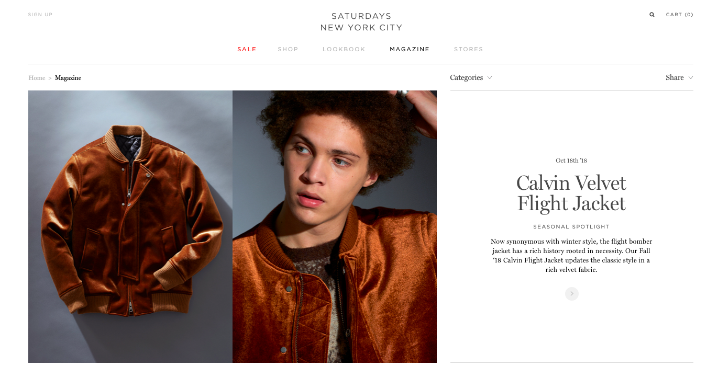
What are competitors doing?
Saturdays NYC; "the trendy one”
Saturdays NYC
GQ Best New Menswear Designers in America 2016.
Focus on lifestyle element heavily displayed in brand image and content.
Website successfully mixes compelling product imagery with complimentary editorial content and video.
Notes:
We used Porter’s 5 Forces to analyse Tonn’s current position. Given that the retail and clothing industry is an extremely saturated market we decided to focus on what Tonn’s competitors were doing. Here we spotted opportunities in which Tonn could re-position themselves in order to differentiate themselves further.
Tonn’s competitors have done a good job at positioning themselves.
They know who they are and customer can see that clearly throughout their website and branding.
A blog post by the Idle Man detailed how Saturdays NYC came about. “In 2009, Saturdays NYC’s founders Colin Tunstall, Morgan Collett, and Josh Rosen combined their mutual love of surf culture with their interests in design, music, and coffee, amongst other things. The result? Probably one of the coolest stores in New York.” Tonn can learn from Saturdays in terms of their exploration of the ‘trendy’ lifestyle image portrayed by the brand, a lifestyle that their customers strive to obtain.
References:
20 Modern, Clean Ecommerce Sites, for Inspiration. 2018. Practical Ecommerce. Available from: https://www.practicalecommerce.com/20-modern-clean-ecommerce-sites-for-inspiration [Accessed November 22, 2018].
Everything You Need to Know About the All-Stars Behind Saturdays NYC | GQ. Available from: https://www.gq.com/story/saturdays-nyc-best-new-menswear-designer-all-star-interview [Accessed November 22, 2018].
Ueland, S. Saturdays NYC | Shop Men’s Shirts, T-Shirts, Boardshorts, Footwear, Sweats, Sunglasses, Pants and More. Available from: https://www.saturdaysnyc.com/ [Accessed November 22, 2018].
Kirby, E. 2018. History of Saturdays NYC. The Idle Man. Available from: https://theidleman.com/manual/arrivals/history-saturdays-nyc/ [Accessed November 22, 2018].

Slide 8
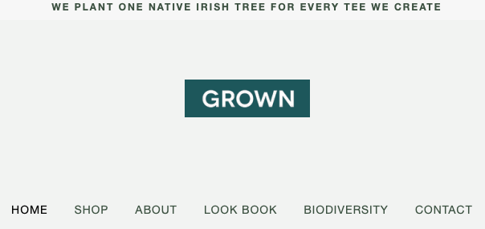
What are competitors doing?
GROWN; "the tree hugger”
Grown
Ethical aspect of brand cemented into their brand image, not just the clothing they produce.
“One tree for ever tee”
CSR in sustainable initiatives across Ireland ‘BIODIVERSITY BUY BACK’
Notes:
Similarly, Tonn can learn from how GROWN, another Irish clothing manufacturer, has been successful in imprinting sustainability into their branding, not just the manufacturing of their products.
“Irish ethical clothing company that is inspired by the sea, coast and wildlife of Ireland. We only use organic, post-consumer and earth friendly material”- Grown.ie (2018)
There is an opportunity for Tonn to learn from GROWN and their implementation of CSR related activites ’Biodiversity Buy Back’ that help them to resonate as a ‘tree-hugger’ in the eyes of the growing eco-friendly consumer segment.
References:
BIODIVERSITY. GROWN. Available from: https://www.grown.ie/biodiversity/ [Accessed November 22, 2018].
GROWN. GROWN. Available from: https://www.grown.ie/ [Accessed November 22, 2018].

Slide 9
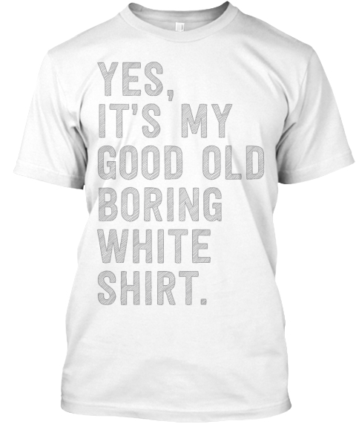
Why can’t Tonn be both?
Consumers are quick to associate ‘sustainable’ or ‘environmentally friendly’ products with boring design and lackluster fit.
Tonn can seek to remove ‘stigma’ around eco-friendly fashion.
‘Customers who love to stand out in a crowd and feel like their purchase hasn't cost the Earth’
Notes:
As consumers continue to become expectant of ethically produced goods, perhaps there is a market for people who want to help the environment but don’t want to sacrifice their appearance.
Here we have identified an opportunity of Tonn to foster both a lifestyle and trendy image while also emphasizing the sustainable aspect of their clothing.
‘Customers who love to stand out in a crowd and feel like their purchase hasn't cost the Earth’
This is a statement by Tonn on their website, but it is the only mention or suggestion of fashion x sustainability throughout their content, branding, packaging. This statement is the backbone of what we would suggest Tonn should base all of their marketing efforts on.
Reference:
Tonnstore.com Our Story. tonnstore.com. Available from: https://tonnstore.com/pages/our-story [Accessed November 22, 2018].

Slide 10
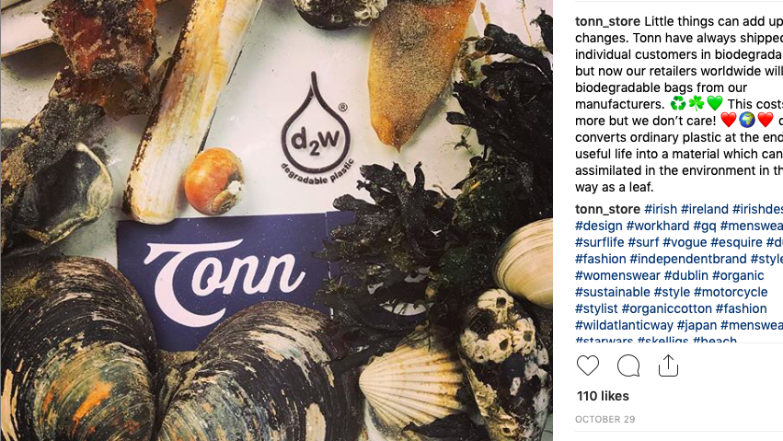
Sustainable shoppers on the rise
21% of people say they would support brands that clearly convey sustainability aspects through their marketing and packaging.
Tonn have already began to take the sustainability further to their packaging.
Willingness to pay 25% higher price for organic cotton
Notes:
A total of 306 students were surveyed at a large Southeastern U.S. research intensive university. The mean age was 20.7 years with a standard deviation of 2.1. Thirty‐eight percent were men and 62% were women. There were several ethnic groups represented, but the vast majority were Caucasian (79%). Asians were the next largest group (8%), followed by African American (5%), Hispanic (4%) and Other (4%). All academic ranks were represented with 35% being Seniors, 23% being Juniors, 21% being Sophomores, 16% being Freshmen and 5% being graduate students. Students’ monthly discretionary income ranged from less than $100 to more than $400.
According to a recent Unilever study, sustainability issues are increasingly affecting shopping decisions (Econsultancy, 2017))
References:
Gillil, N. 2017. How ethical fashion brands are marketing to conscious consumers. Econsultancy. Available from: https://econsultancy.com/how-ethical-fashion-brands-are-marketing-to-conscious-consumers/ [Accessed November 22, 2018].
Rahman, S., Saleem, S., Akhtar, S., Ali, T., & Khan, M. ( 2014 ). Consumer's adoption of apparel fashion: The role of innovativeness, involvement, and social values. International Journal of Marketing Studies, 6, 49 – 63.
Ellis, J. L., McCracken, V. A., & Skuza, N. ( 2012 ). Insights into willingness to pay for organic cotton apparel. Journal of Fashion Marketing and Management: An International Journal, 16, 290 – 305.
McGlone, T., Spaine, J. W., & McGlone, V. ( 2011 ). Corporate social responsibility and the Millennials. Journal of Education for Business, 86 ( 4 ), 195 – 200.

Slide 11
New Positioning Statement
‘Tonn’s goal is to be the first choice for environmentally-aware consumers with our comfortable and stylish clothing that is ethically created.
We do this through a small number of relationships with transparent manufacturers, by using materials that give an amazing vintage look and feel and ultimately telling a story with the graphics.‘
Notes:
From analyzing competitors positioning and reflecting on Tonn’s ‘Our story’ section on website, we decided to generate a new positioning statement that we felt would further differentiate Tonn as a trendy sustainable clothing provider, something that is niche and holds real value for a lot of consumer segments.
Reference:
Tonnstore.com Our Story. tonnstore.com. Available from: https://tonnstore.com/pages/our-story [Accessed November 22, 2018].

Slide 12
Targeting
Story-telling aspect found on the tag brings authenticity to this eco-friendly t-shirt.
Tonn can grab the target audience's attention with its ethical sourcing, but that the t-shirts are also fashionable as well.
Target: Image oriented conscious consumers.
Sustainable shoppers are not to be defined by gender or age group.
Notes:
Currently Tonn tend to be targeting young males between the ages of 18-24 whereas most of their sales supposedly come from females buying a gift for their husbands. Her eco-friendly clothing should be promoted to environmentally conscious buyers, the story telling found on the tag brings a sort of authenticity to this eco-friendly t-shirt. It seems Tonn themselves don’t fully know who their target market is but they should build towards the example of the target audience as seen on the slide and develop fashionable products to suit them, image oriented people

Slide 13
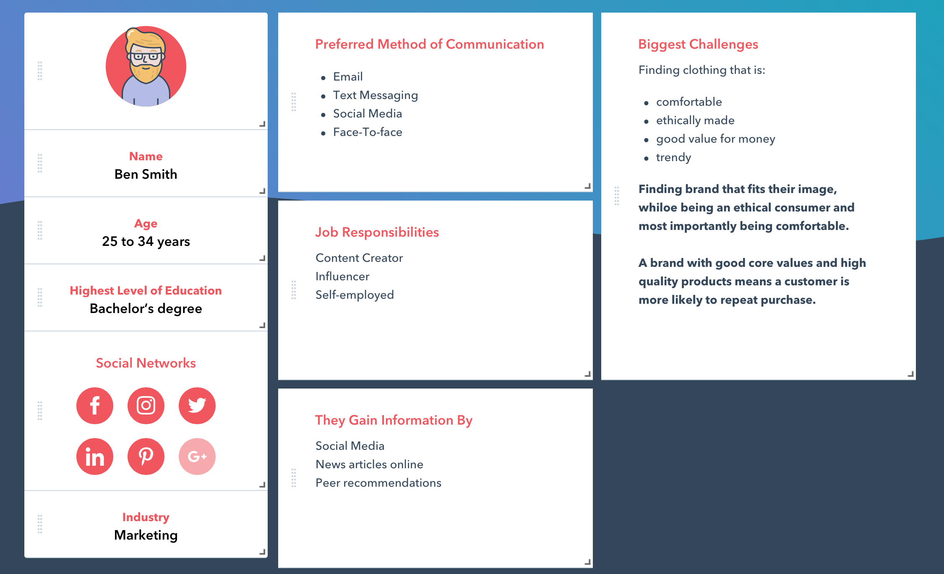
Notes:
From looking at who Tonn appear to be marketing to we came up with this buyer persona. The buyer persona we came up with tends to be a Eco-friendly consumer, they are tech-savy, with a job related to technology, and their clothing preferences are parallel to desirable aspects of the clothing Tonn has to offer, comfortable ethically made, and trendy. Goal is to gain positive attention from this segment with Tonn’s new sustainable branding while simultaneously creating a community for people who purchase sustainable products.

Slide 14
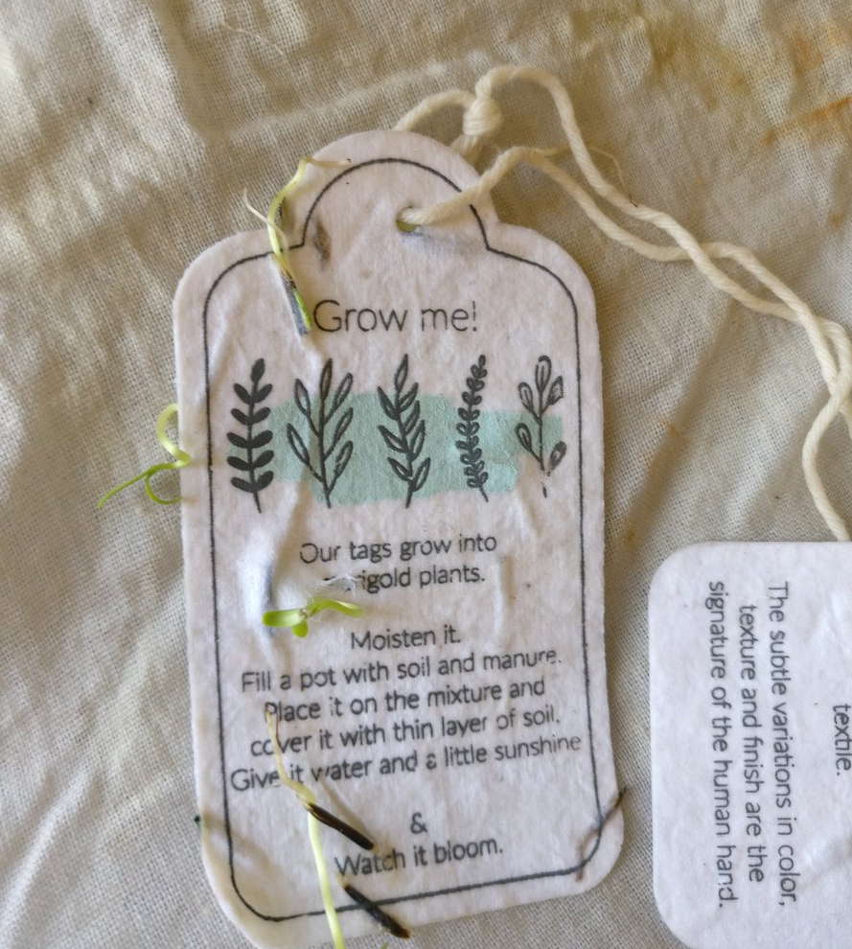
Branding Recommendations 1. Innovate as part of CSR
Introduce eco-friendly clothes tags containing seeds
Avail of compostable packaging and promotional material (i.e. business cards, leaflets, brochures)
Notes:
Introducing eco-friendly clothes tags that contain seeds would continue to draw a positive image for Tonn in the eyes of the consumer, planting these tags is more environmentally friendly than discarding of them. This idea would appeal to the environmentally conscious consumer. The average plantable tags are less expensive than ordinary ones, so it comes with 2 benefits to Tonn.
Reference:
Admin 2013. The Benefits of Using Seed Paper. Custom Earth Promos. Available from: https://www.customearthpromos.com/eco-blog/benefits-of-seed-paper/ [Accessed November 28, 2018].

Slide 15

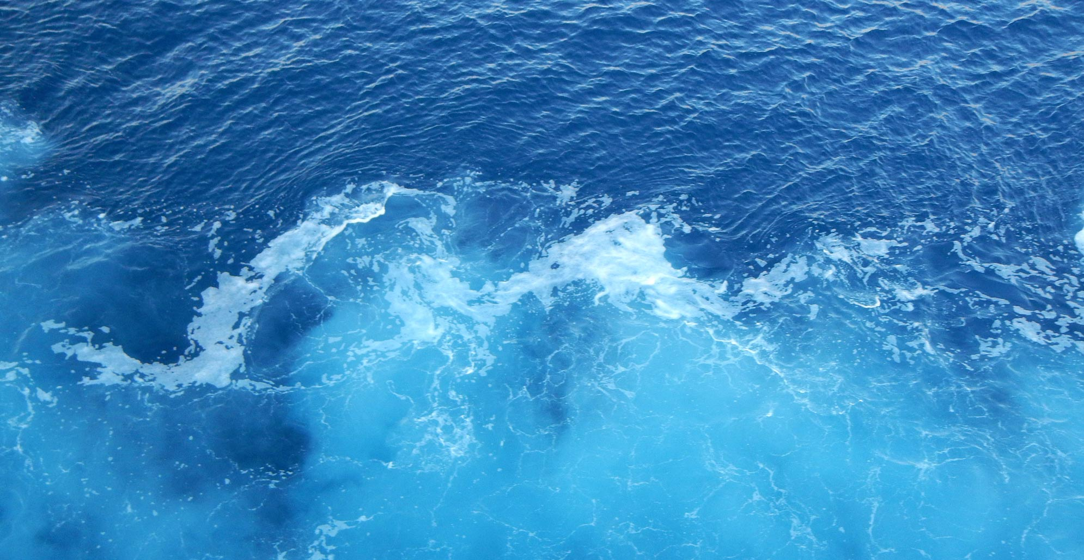
2. Combination of Cause-Related and Content Marketing
Use content marketing to showcase sustainability is a core value for your business
Organise a fundraiser in Spring/Summer 2019 in partnership with Clean Coasts
Incentivise attendance by offering inclusion in a private club Tonn Clann
Invite photographer/videographer to generate content from events
Notes:
To work beyond their current ethical position, Tonn will take it a step further with a combination of Cause-Related Marketing and CSR, to increase awareness, sales, and communications content.
Creating and sponsoring an Ocean Clean-up event, initially in Ireland with the vision of expanding globally to attach Tonn to a cause.
Beyond contributing to the philosophy of Tonn, this will aid the brand in terms of Corporate Social Responsibility and utilise cause-related marketing to connect to customers and drive up the perceived value of the products.
Cone Communications research indicates a 170% increase in purchasing of products associated with a cause (PR Newswire, October 2013).
Utilise these events to create a following for the brand; create a ‘family feeling’ to the brand; a ‘Tonn Clann’ (Irish for Family). This will be a loyalty club, for attendees of events and frequent buyers, who are offered rewards in terms of opportunities to purchase exclusive products.
This connects Tonn with customers who value Tonn’s vision, and who will support its efforts in sustainability.
Having photographers and videographers at these events will result in content, build awareness and opportunities for better communication- so get the highest value out of conducting the socially-responsible events.
This aims to follow the example set out by Darkness into Light, an initiative where the event can take place on the same day internationally.
This approach allows Tonn to act in a socially responsible way, without any main drawbacks or loss of profit, and will ideally drive sale through reminding customers of the ethical background of the products, and the philanthropic philosophy of the company. Consumers are willing to pay substantially more for ethically produced goods than for unethically produced goods. (Trudel and Cotte, 2009)
“Social features of products can, on average, affect an individuals' likelihood of purchasing a product.” (Auger et al., 2008)
References:
Cone Communications (2013). American Enthusiasm To Shop With A Conscience At Record-High, But Doubts About Corporate Impact Persist. [online] Prnewswire.com. Available at: https://www.prnewswire.com/news-releases/american-enthusiasm-to-shop-with-a-conscience-at-record-high-but-doubts-about-corporate-impact-persist-226133901.html [Accessed 28 Nov. 2018].
Trudel, R. and Cotte, J. (2009). Does It Pay To Be Good?. [online] MIT Sloan Management Review. Available at: https://sloanreview.mit.edu/article/does-it-pay-to-be-good/ [Accessed 28 Nov. 2018].
Auger, P., Devinney, T., Louviere, J. and Burke, P. (2008). Do social product features have value to consumers?. International Journal of Research in Marketing, 25(3), pp.183-191.

Slide 16
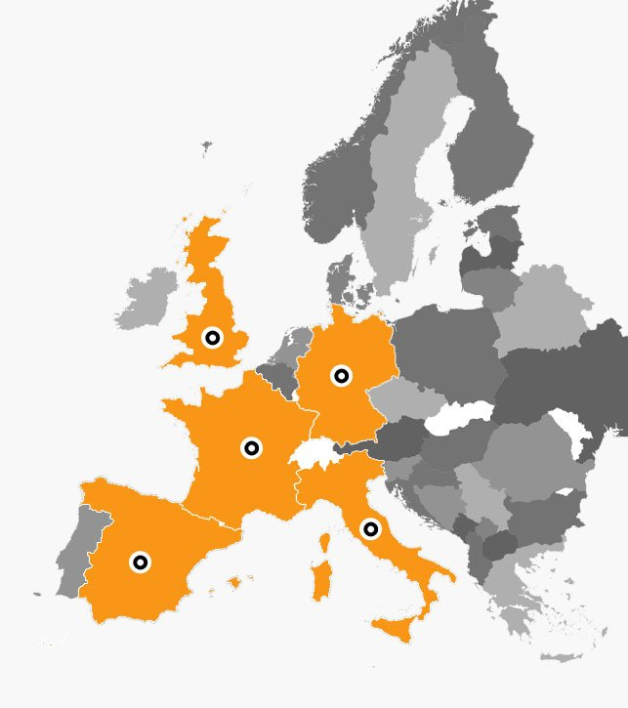
Distribution Recommendation Expand distribution channels - Amazon
Engage with fulfillment networks (e.g. Fulfillment By Amazon)
Exposure to millions of Amazon users
Amazon picking, packing and shipping goods to customers within 1)UK 2) 7 EU countries (depending on subscription method)
Notes:
Utilising a new distribution strategy of outsourcing will provide Mary with more time to focus on other aspects of the business.
Amazon offers ’Fulfillment’ distribution networks which will expand Tonn’s reach and provide outsourcing of the storage, packing and shipping of the products.
Price per unit: roughly £1.97(UK); €4.15 (EFN)
Pay per cubic foot storage (monthly)
Price of one t-shirt stored in unit:
£0.07 Jan-Sept, £0.09 Oct-Dec (UK);
€ 0.08 Jan-Sept, € 0.11 Oct-Dec – EFN;
Price per cubic foot
£0.65 Jan-Sept, £0.91 Oct-Dec (UK);
€26 Jan-Sept, €36 Oct-Dec (EFN).
access to order reports and order-related feed; optimised advertising solutions (Amazon 2018).
*EFN – European Fulfilment Network stored in Germany, France, Italy, Spain, Poland and Czech Republic
References:
Amazon (2018). 2018 Fulfilment by Amazon fee changes (Europe) – Amazon Seller Central. [online] Sellercentral.amazon.co.uk. Available at: https://sellercentral.amazon.co.uk/gp/help/external/201411300 [Accessed 28 Nov. 2018].
Amazon (2018). Sell on Amazon - Features & Benefits - Amazon.co.uk. [online] Services.amazon.co.uk. Available at: https://services.amazon.co.uk/services/sell-online/features-and-benefits.html?ref=UK_SOA_home_Fbmore [Accessed 28 Nov. 2018].

Slide 17
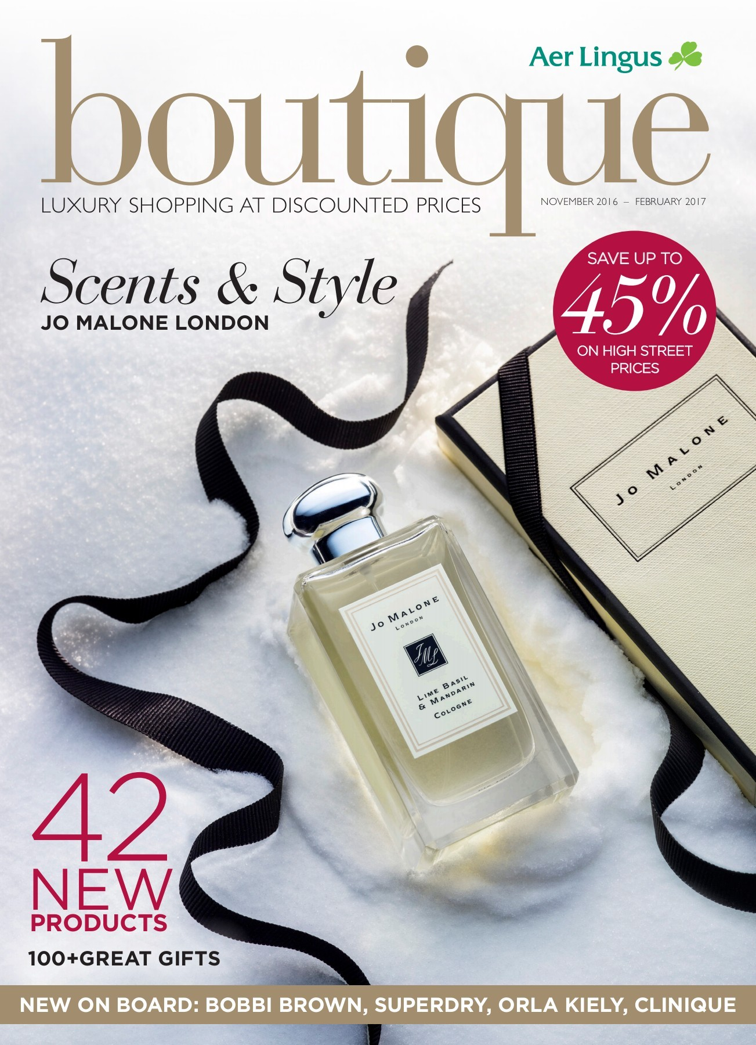
Long term goals
Approach Snowsports segment
Offline distribution channels: Aer Lingus in-flight magazine, partner with visitor centres around Ireland and guided tour companies in Ireland/luxury hotels
Connect with Irish Diaspora by attending events like The Gathering, Sea Sessions, Lahinch Golf
Product differentiation based on geographical location: e.g. Ireland versus Japan
Notes:
Resolves other problems for same clientele: Winter Apparel for existing customers
Focus on producing winter themed sweatshirts and long-sleeved tees
Addresses seasonality issue
Consider selling existing tees at discounted rate for future Black Friday/Cyber Monday and holiday sales
Further address seasonality & global awareness issues by advertising the brand in in-flight magazines of high-end airlines such as Aer Lingus and Emirates during Christmas and other holidays, when Irish immigrants living in Southern Hemisphere come home and seek to purchase high quality gifts on flight back.
Heightened perceived brand status.
Increase presence at events like The Gathering, Sea Sessions, Lahinch Golf.
Partner with visitor centers around Ireland and Guided Tour companies such as Paddy Wagon, who have agreements with high-end local souvenir stores around Ireland, bringing thousands of foreign tourists into them daily. Start off by exhibiting products in these shops for a commission fee.
Partner with luxury hotels in Dublin to display promotional material on their information stands (use organic materials proposed in Step 1 of short term strategy) or alternatively sell products through local hotel stores that are present in most high-end hotels.
Common long term goals: Develop a community within target market, initially Ireland with hopes of eventually connecting with diaspora in Australian/US markets, Increase sales
Diverse/unclear content – is it always about ‘Irishness’? Surfing related? Is the message always clear to international buyers?
Debatably Irish retailers and Irish diaspora will be similar in characteristics when it comes to shopping. Ireland and Japanese consumers both engage in large amounts of retail shopping with both countries consumers being attracted to eco-friendly products.
Irish Retail Consumers
•Remains cautious and value-conscious.
•77% willing to pay for same or next day delivery.
•Mobile shoppers
•Driven to purchase by social media
Japanese Retail Consumers
•Novelty seeking.
•High quality standards and service expectations.
•Enjoy ‘fun’ element of shopping.
•Attractiveness of imported goods.
References:
PricewaterhouseCoopers Irish Retail and Consumer Report 2018 — Planning for disruption. PwC. Available from: https://www.pwc.ie/reports/retail-consumer-report-2018.html [Accessed November 23, 2018].
The Japanese Consumer Mindset | LinkedIn. Available from: https://www.linkedin.com/pulse/japanese-consumer-mindset-philippe-huysveld-ir-mba/ [Accessed November 23, 2018].

Slide 18

Tactics to achieve goals Influencer Marketing
48% of brands intended to increase influencer spending in 2017.
Choose an influencer who has previously expressed interest in Irish brands and Eco-Friendly brands. This means they have authenticity already in this area and are likely to have following that are interested in two areas.
Notes:
Send t-shirts to influencers/models in hope that they wear/post them without paying them is Mary’s current strategy towards influencer marketing.
In most cases it is not enough to send a t-shirt ‘hoping’ that they like it and wear on their own accord while simultaneously posting about it online. We feel like Mary is underestimating the power of influencer marketing in promoting her brand. There is the option to pay online influencers who are known for being eco-friendly ambassadors, where Tonn also have control over the messagint hat accompanies the t-shirt feature.We reached out to Niamh O’Sullivan, an Irish micro-influencer who has worked with a variety of well-established brands. If she were to promote Tonns products we have no doubt that it would increase sales.
References:
How to work with influencers | WARC. Available from: https://www-warc-com.dcu.idm.oclc.org/content/article/bestprac/how_to_work_with_influencers/111229 [Accessed November 20, 2018].

Slide 19
Action | Entity responsible | Platform/Means | Budget | Implications for Tonn
Growing the sustainable packaging | Mary or her husband | Sustainable eco packaging distributors | Under 20c/tag | -Retention of sustainable customers -Acquiring new customers who care about environment
Event partnership w/ charity (CSR) | Mary (possibility of outsourcing to Events Intern or Agency) | Multi-platform awareness campsign: Radio Social Media Local newspapers | -€2-5K on branding and promotion (if done in-house) | -Increased awareness of brand -Possibility of free content/ media pick up on event -Further cementing Tonn’s positioning --WOM marketing -Engagement with customers and a cause -improves corporate image
Amazon distribution | Mary | FBA | PPU: £1.97 per t-shirt - UK; £4.15 - EF PPCF: £0.65 Jan-Sept, £0.91 Oct-Dec (UK); €26 Jan-Sept, €36 Oct-Dec (EFN). | -Reaching new segment of customers. -Optimised search . -Amazon dispatching goods for Tonn. -Stored in 7 countries.
Influencer Marketing | Mary (PR contacts could be of assistance) | Instagram Influencers- namely Niamh O’Sullivan, Kildare blogger who loves showing her followers Irish and Sustainable Shopping | Organic (written by Niamh) post about Tonn=free (Tonn control message- cost involved) | - Awareness among Target market -Assists Positioning as sustainable Irish Brand -Piggy-back off Influencer content
CRM (Tonn Clann) | Outsourced system | CRM System ie. Accelo for SMEs | €15-30 p/month | -Less personal than doing it in-house -Better customer relationships -Improved cross-selling -Improved efficiency in serving clients
Content creation | Mary (Videographer intern) | Web site Social media Create Videos | Price may vary depending on experience of the videographer | -builds creditability -brings traffic to website, increases conversion rate -improves SEO
Media creation | Mary | Online channels Social Media | Free | -promotes brand -Increases engagement with brand -increases brand awareness
Notes:
Sustainable Packaging
Sustainable packaging that may include plantable wrapping and tags that are still novel and draw attention from the public. We researched how much such packaging might cost and found out that on average plantable tags are less expensive than ordinary ones. Example: https://www.etsy.com/listing/208448727/seed-paper-giftproduct-tags-125-wide-by?ga_order=most_relevant&ga_search_type=all&ga_view_type=gallery&ga_search_query=plantable+gift+tags&ref=sc_gallery-1-4&plkey=6ca15998dabc10e095ef3a4aa17acfe547b3baac%3A208448727. Such tags can be customised.
CSR Strategy CSR based marketing strategy could be extremely effective for Tonn in the promotion of their brand while simultaneously doing good for the local environment and cementing their image as a eco-aware brand. Our idea for Tonn was for them to co-ordinate or sponsor a beach clean-up
Again, Mary’s PR contacts could be utilised and suitable influencers could be invited, in hopes of generating some free media.
Photographer for new content. The goal of this strategy would again be to build awareness amongst Tonn’s target market, environmentally concerned people. Influencer Marketing We believe that influencer marketing could be extremely useful for Tonn to increase awareness of brand among their target audience. We would consider Tonn’s target audience as wide as anyone who likes to consumer high quality eco-friendly products, be that male or female of a relatively wide age grouping. The rise of influencers also means it is more important than ever to be picking the right one, the authenticity of the link between the influencer and the product is extremely important in terms of customer adoption. A Forbes article (2018) also describes influencer marketing as a way in which marketers can shorten the path to purchase.
We reached out to what we thought the ’ideal influencer’ for Tonn would be. Niamh O’Sullivan is a 20 something blogger from Kildare who specialises in Lifestyle and Fashion. She is always promoting (sometimes paid, sometimes organic) Irish and or Sustainable products to her fans.
We messaged Niamh, inquiring about the usual cost/procedure for a brand sponsoring a post on her Instagram. Below is her reply, ‘Hey! Usually if a brand wants to work together on something specific and if they want to control the messaging, then there would be a fee involved. But for me personally because I want to try and push small businesses and especially Irish and ethical ones, I would definitely be happy to promote it myself as long as I can do what works for me and my audience. Just because it aligns so well with what I’m talking about in general’
CRM (Tonn Clonn) Utilsing a CRM system is no longer an option for businesses operating online, it is essential. Connecting with Tonn’s regular clients and inviting them to be a part of the ‘Tonn-Clonn’ will result in better customer relationships, better customer service and improved sales and revenue. The ‘Tonn Clonn’ is a way to connect with the Irish Diaspora and people who are passionate about the brand.
There is a wide range CRM software available, which cater to the different needs to different businesses, and offered at different levels (Buttle, 2015), so Mary can choose one that suits her needs as her market expands and grows. This system will benefit customer satisfaction and ultimately drive sales and word of mouth marketing due to good customer service.
Content creation
We believe content creation can help attract, engage and satisfy the target market by delivering quality content on both the website and social media platforms. Updating social media channels and the website regularly with content that interests the target market can be very effective, creating a product catalogue on Instagram with the option to buy now we think would be very effective for sales. Investing in a brand video targeting eco-conscious buyers can increase online brand awareness and convert traffic on to the website into sales.
Standberry, S., 2017. Top 25 Benefits of Content Marketing & How It Can Grow Your Business. Digital Marketing Blog. https://www.lyfemarketing.com/blog/benefits-content-marketing/ accessed(26.11.2018)
Media Creation
With similar effects as content creation media creation can increase brand awareness through social media platforms and increase online presence. Media creation can establish relationships with customers through the personal effects of social media and in turn gather data on the target market and create sales.
References
Ward, T. The Influencer Marketing Trends That Will Dominate 2018. Forbes. Available from: https://www.forbes.com/sites/tomward/2017/12/01/the-influencer-marketing-trends-that-will-dominate-2018/ [Accessed November 22, 2018].
Buttle, F. (2015). Customer Relationship Management. Taylor and Francis.

